Slide 1
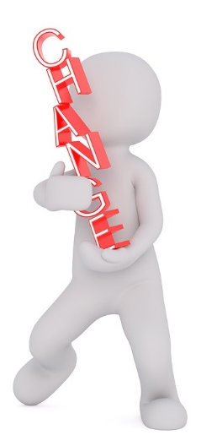
Summary of the Project
The knowledge you’ll gain of a global issue will form the basis of an activity that you will create and present to your peers, enabling you all to become ChangeMakers!
Throughout the project you’ll develop your ability to think critically, analyse and solve problems, plan positive action and communicate your views.
The project is comprised of 4 taught sessions:
Session 1: Develop knowledge and understanding of the global issue
Session 2: Reflect on your research and think critically about how to make change happen. Develop peer education and facilitation skills
Session 3: Support with the planning of the peer education activities
Session 4: Reflection and review of the project after the peer education activities
Between sessions you will need to continue researching and planning your event before delivering it your peers following session four.
Notes:
Explain which global issue you will be focusing on – fashion, mobile phones or refugees
Picture credit: https://pixabay.com/en/white-male-3d-model-isolated-3d-1874779/

Slide 2
Timeline
Schools deliver ChangeMakers peer education activity/ies with support of teachers
Session 4 to take place to reflect and review the project.
Students and teacher continue to plan the peer education activity.
Session 1 to take place.
Session 2 to take place.
Following session 1 students research the themes connected to the global topic and begin to plan first stages of peer education activity together with lead teacher.
Following Session 2 students continue to plan the activity
Session 3 to take place to further support plans.
Teachers and group continue to work independently (including creating on action plan for future activities)
Notes:
Suggested timings within the school year

