Slide 1
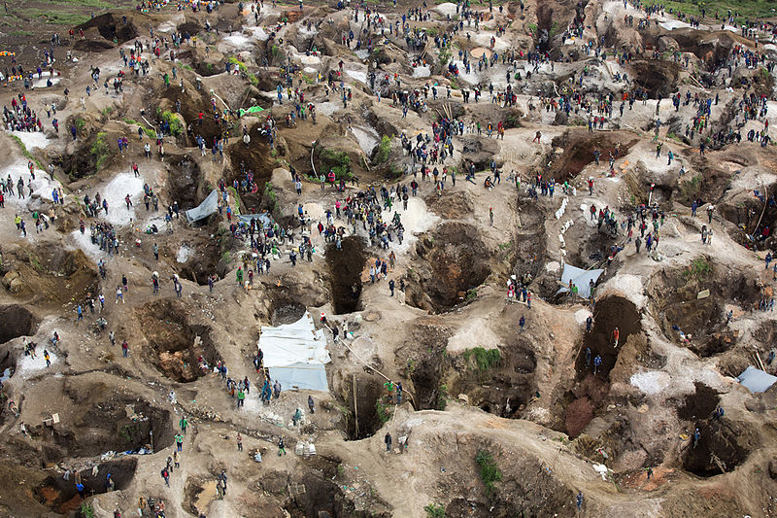
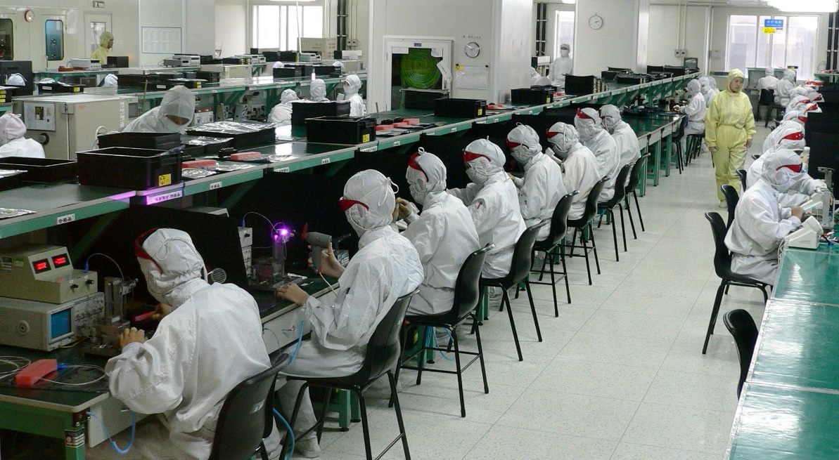
Mobile phones
In this session, we will:
Develop knowledge of mobile phone production and its positive and negative impacts, both locally and globally
Think critically about the positive and negative impacts of mobile phone production and use
Identify the positive change that can be achieved even in the most difficult of circumstances
Notes:
Introduce session and learning objectives.
(pictures – Coltan mine in Democratic Republic of Congo (DRC), iphone, electronics factory in Shenzen, China)
Photo credits: https://commons.wikimedia.org/wiki/File:SRSG_visits_coltan_mine_in_Rubaya_(13406579753).jpg; https://en.wikipedia.org/wiki/Electronics_industry

Slide 2
Agree or disagree?
I like to have the latest technological gadgets and don’t really think about what happens to the old ones
I’m not bothered that the technologies I use cause problems for people involved in producing the product
Everyone should have access to technology they need, even if they can’t afford it
It’s impossible to get by without a mobile phone
Scientists and engineers should be given incentives to create technology that helps poor people and doesn’t harm the environment
Scientists and engineers should be free to create whatever technology they want
I don’t really know much about where my mobile phone and other technology comes from
Notes:
Put the statements on the slide one by one and ask students to stand on a agree/disagree continuum – optionally, take a photo. You can repeat the activity after the workshop to see if there has been a change. Alternatively, put the sentences on flipchart and ask learners to put stickers on agree/disagree continuum.
Ask the learners: Who has a phone? In groups or pairs ask learners to discuss their mobile phones, noting the positive and negative impacts sticking them on a ‘positive’ and ‘negative’ wall. Keep this ‘wall’ available throughout the session and give learners opportunities to add to the wall as they go through activities.

Slide 3
Mobile phones
What are the positive and negative impacts of your mobile phones?
Notes:
Ask the learners: Who has a phone? In groups or pairs ask learners to discuss their mobile phones, noting the positive and negative impacts sticking them on a ‘positive’ and ‘negative’ wall. Keep this ‘wall’ available throughout the session and give learners opportunities to add to the wall as they go through activities.

Slide 4
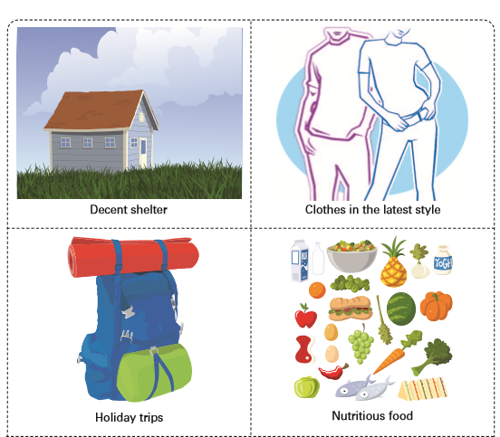
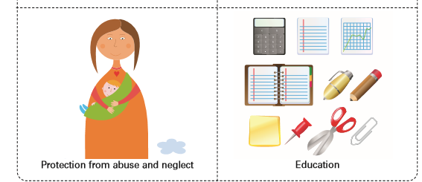
Needs and wants
What can’t you live without?
UNICEF Rights, wants and needs cards, http://bit.ly/2cMO8zq
Notes:
In groups, ask learners to come up with a list of things that they need – that they couldn’t live without. Ask them to negotiate until they agree in their groups. Discuss as a class any points of disagreement. Discuss: Is your mobile phone something you want or something you need?
Optional resource: Use the UNICEF Needs and Wants cards to facilitate the needs/wants activity discussion – ask learners to categorise the cards into things they need and things they want, and to add anything they think is missing.

Slide 5
What makes a mobile?
What do you think is in your mobile phone?
What’s in your mobile? (video)
Notes:
Ask learners to look at their mobile phones and to list what they think is in them – they can think about different parts (keys, speaker, mic) and the components of those parts (plastic, etc). Now watch this video showing all the elements in the phone – students can compare their lists to the items in the video (Sheffield Hallam).
Photo credit: https://c1.staticflickr.com/4/3498/3261613714_b77b7476fa_b.jpg

Slide 6
Life cycle of a mobile phone
Disposal
End of life
Materials processing
Recycling
Reuse
Materials extraction
Useful life
Manufacturing
Packaging and transportation
The life cycle of a mobile phone (video)
Notes:
Talk through the life-cycle of the mobile phone and watch the video to summarise up until 5.08 minutes. Look through slides 7-9 about these stages and ask learners to add positives and negatives to the wall

Slide 7
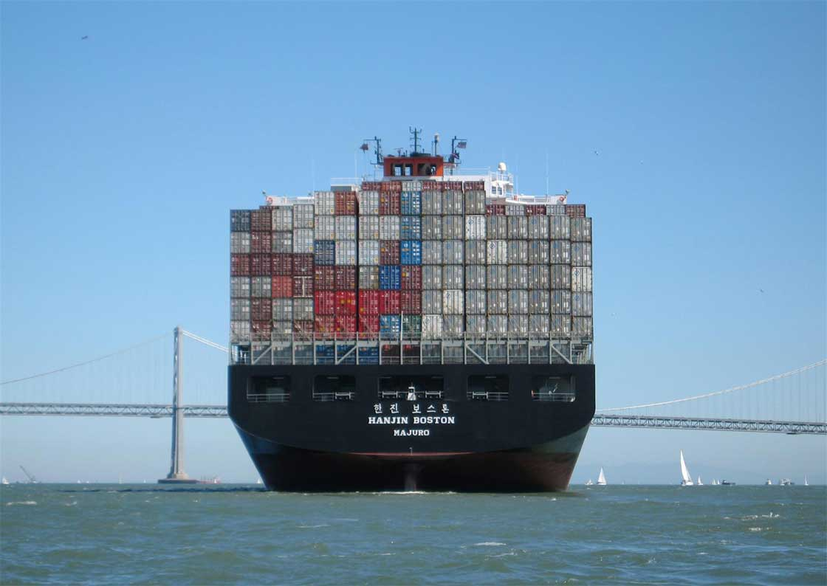
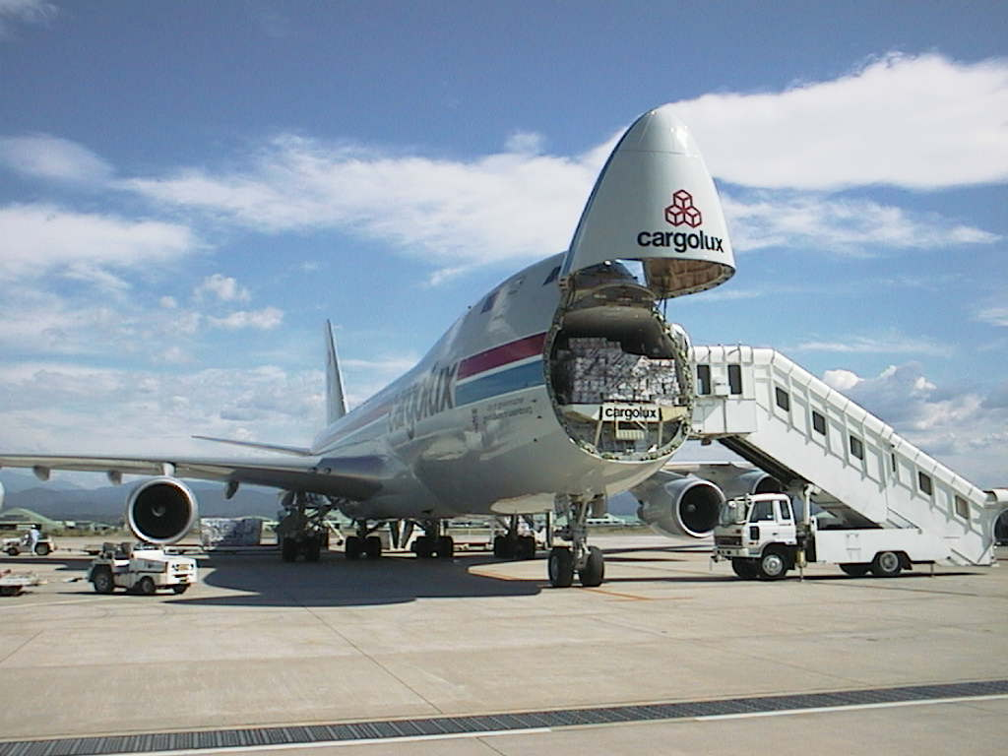
Packaging and transportation
Transportation requires the use of fossil fuels that contribute to climate change.
Packaging consumes valuable natural resources, such as trees, oil, aluminum or other materials, all of which use energy to produce and can result in waste.

Slide 8
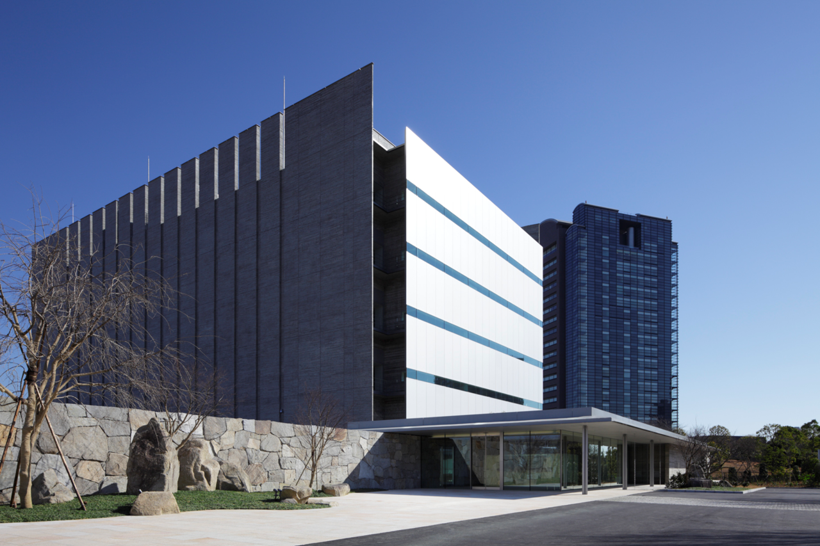
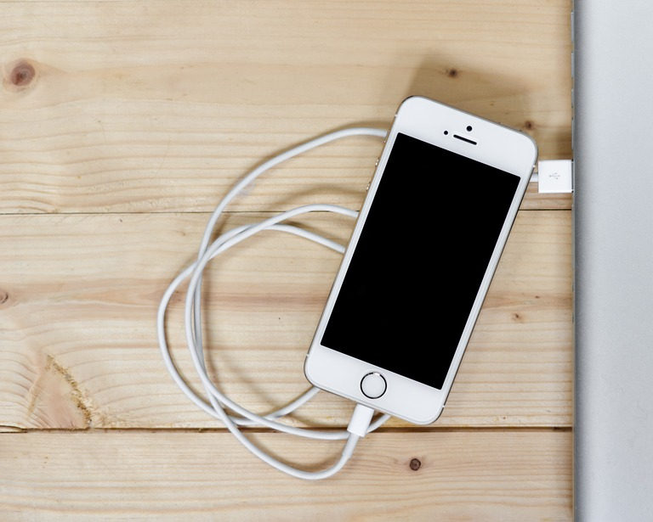
Useful life
The 416.2 terawatt hours of electricityused by the world’s data centres in 2016 was far higher than UK’s total consumption (Independent)
Globally, mobile calls account for about 125 million tonnes os CO2e, which is just over one-quarter of a per cent of global emissions (Guardian)

Slide 9
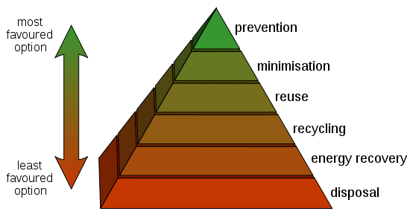
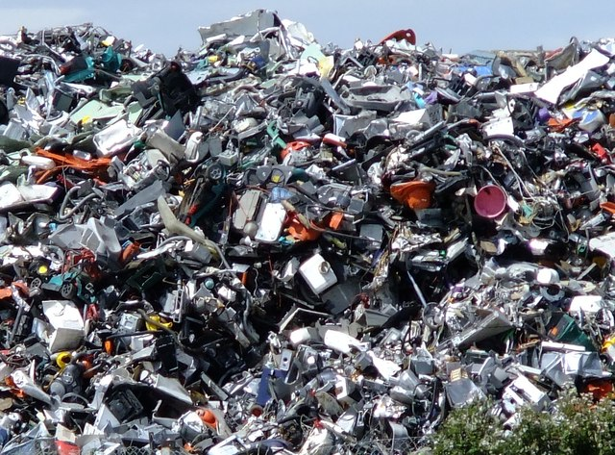
End of life

Slide 10
Materials extraction: focus on the DRC
What negatives about mobile phones come out of watching the films?
What are the key phrases they pick up from the films?
Who are the winners and losers of the mobile phone industry?
What part do we play in the problem and solution?
Movie : Conflict Minerals 101
Notes:
We’ve looked at some of the minerals in a mobile phone, and where they come from. One big producer of the minerals for mobile phones (and other electronics) is the Democratic Republic of Congo (show on map).
Ask learners to work in small teams to complete the true/false quiz on the slide – give answers and discuss background information.
Show TED talk by Bandi Mbubi (from Congo Calling) and ask the learners to note 3 things they learnt from the video. Discuss learning points and questions.
Now watch 2 films introducing conflict minerals in DRC:
Conflict Minerals 101 (until 3.03mins - produced by the Enough Project). This explains clearly which minerals we’re talking about, where they’re found (DRC) and how they’re used to fuel conflict.
Blood in the Mobile film trailer – documentary looking at impact of conflict minerals in DRC (available to buy here).
Following the discussion, add things to the positive and negative impact wall.
Extension: Learners can read a Guardian article by the documentary maker for background information.

Slide 11
Manufacturing: Focus on China
Task: Read one of the articles about FoxConn – the supplier for many major electronics firms (e.g. Apple, working conditions or inside the Chinese factories).
Share 2-3 main points with the rest of the class.
Notes:
We’re now going to look at the next stage in the process – taking the refined minerals (metals) and turning them into the phones (and other electronic items). Much of this takes place in China.
Ask learners to work in small teams to complete the China true/false quiz on the slide – give answers and discuss background information.
Case Study Foxconn:
We’re going to focus on Foxconn – the supplier for all the major electronics firms (including Apple, Microsoft etc.)
In small groups, ask the students to analyse one of the news articles below. Ask them to come up with 2-3 key points from their article to share with the rest of the group.
Apple making positive changes in China?
Foxconn Suicide Protest against working conditions
Inside the Chinese factories
Add any positives/negatives about phone to the wall.

Slide 12
Mobile phones for good
Pink phone revolution (article)
Pink phone revolution (video)
Notes:
Photo credit: http://policy-practice.oxfam.org.uk/blog/2012/03/pink-telephones-in-cambodia

Slide 13
What can you do?
Task
Watch/read about an organisation/campaign/technology for change then report back.
What is the intervention/campaign?
Who is doing it?
How will this help?
How effective do you think this could be?
Is this something you could get involved in? Why/Why not? How?
Notes:
We’ve established that mobile phones have good and bad points, and they are certainly not going away, so how can we make a difference to how they are made, used and disposed of so the human and environmental impacts are not so terrible?
Ask learners to watch/read about an organisation/campaign/technology for change listed below and then report back to the rest of the class.
Video from 5.08 onwards (continuation of earlier video)
Fair Phone is the first fairly traded and produced mobile phone!
Green Touch, a consortium dedicated to transforming communications to significantly reduce the carbon footprint of our devices, platforms and networks.
Phonebloks, which tries to reduce global e-waste by creating a modular phone.
Organisation, Toxic Links, which calls for environmental justice and freedom from toxins.
Website of Practical Action who campaign for technology justice

Slide 14
Plenary
Know | Want | Learnt | Surprise
What do we already know? | What do we want to know? | What have we learned? | What surprised you?

