Slide 1
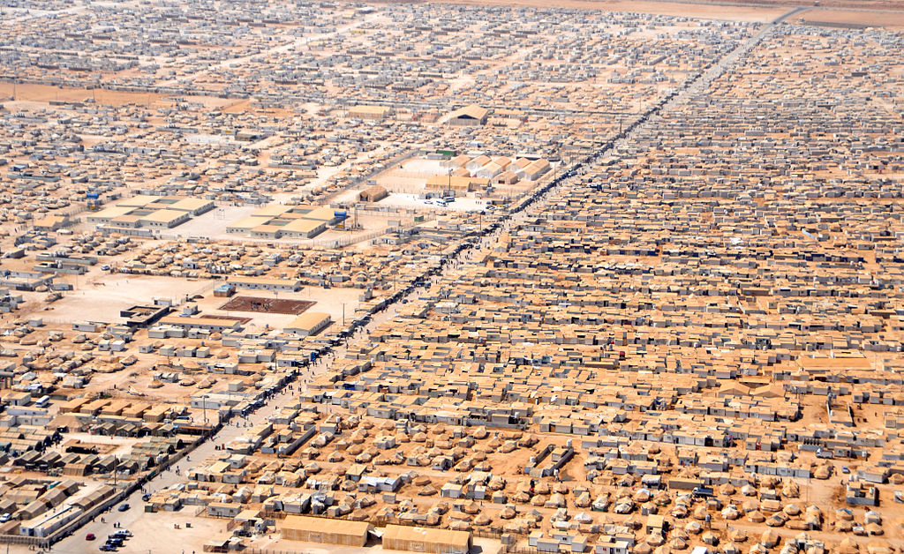

The Refugee Crisis
In this session, we will:
Define refugees and their legal right to be protected
Understand the scale and scope of the refugee crisis
Understand the reasons people become refugees and the impact on their lives
Identify some positive contributions made by refugees in the UK
Critically think about and discuss issues relating to asylum and refuge in the UK
Analyse UK media coverage of the refugee crisis in Europe
Critically analyse the effectiveness of action to support refugees
Notes:
Starter: Introduce session and learning objectives

Slide 2
What do you already know, think and feel?
x
x
x
x
I agree/this is true
I disagree/this is not true
neither agree nor disagree / I don’t know
Notes:
We’re going to start the session by getting an idea of what you already think and feel about refugees – there are no right or wrong answers. Choose a selection of the following statements. Ask learners to place a cross on the agreement line to indicate their own views on the statement. This can be used as an assessment of distance travelled if repeated at the end of the session. Once you’ve captured the responses, discuss some of the answers and ask people to explain their views.
Knowledge
Most refugees fleeing from conflict settle in Europe.
Migrants are people who have travelled illegally to another country.
Most asylum seekers in the UK do not work because they do not want to work.
Feelings/opinions
People should be allowed to live in any country they want.
We don’t have space in Wales for any more people.
Accepting refugees puts pressure on education, health care and other services.
If I was living in danger, I’d expect others to help me and my family.
Rich countries should help more refugees than poor countries.
The media presents a fair picture of refugees and the refugee crisis.
Wales (or your own area) is a welcoming place for refugees.
All children living without parents in refugee camps should be allowed to settle in the UK.
Overall, refugees bring benefits to the countries where they settle.
Once a refugee’s country becomes safe, they should be made to return home.
Skills
I feel confident communicating my opinions about refugees
I feel confident explaining root causes of the movement of people
People who come to this country for a better life always work hard.
People who come to Wales as refugees are always treated well.
Living in a refugee camp would be exciting.
The best solution to the refugee crisis is to give aid to the countries refugees come from

Slide 3
Quiz: question 1
Match the words with their definitions:
  migrant
  Refugee
  asylum seeker
person who has fled war or persecution who is recognised as needing protection
person who has travelled to another country to live for more than a year
person who has applied to be recognised as a refugee
Notes:
Complete Starter Quiz – slides 2-6

Slide 4
Quiz: questions 2-4
List 3 of the top 5 countries that refugees come from
List 3 of the top 5 countries that refugees go to
Why do nearly all the asylum seekers in the UK not work?
  They don’t want to
  They don’t have good enough English/Welsh
  They don’t have the right skills
  They are not allowed to work

Slide 5
Quiz: questions 5-6
When did the first refugees come to Britain
  January 1945
  In 1685 when Huguenots fled to Britain to escape the persecution of Louis XIV
  208AD
  In 1938 following ‘Kristallnacht’ in Germany
Pop star Rita Ora and former Chelsea footballer Mario Stanic both experienced the same conflict. What was it?
  Yugoslav War
  The French Revolution
  Rwanda’s Civil War
  Syrian Civil War
  Soviet Revolution

Slide 6
Quiz: questions 7-8
During WW1, around 4,500 refugees came to Wales from:
  Germany
  Belgium
  France
  Russia
The right of everyone to seek and enjoy asylum from persecution in other countries entered into international law in:
  1918
  1948
  1970
  2012

Slide 7
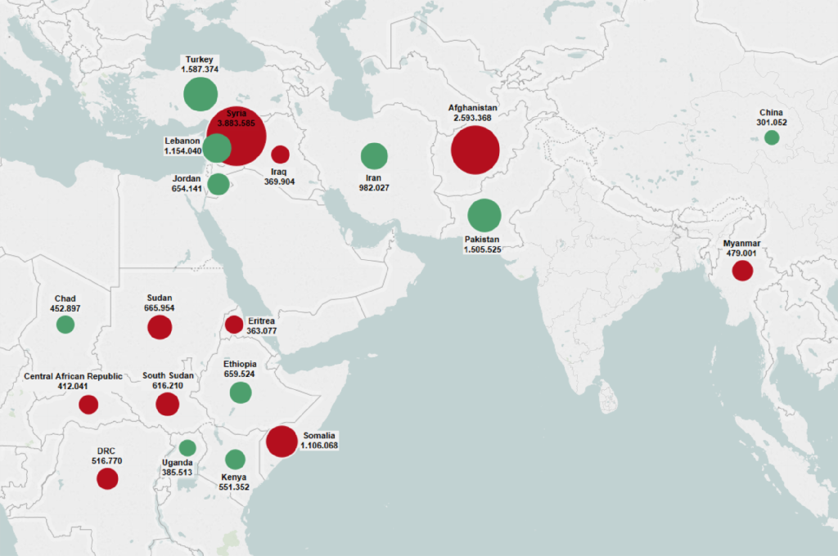
Answers
65.3 million people displaced from their homes due to conflict and violence
Map
Top 10 countries of origin of refugees (red) and asylum applications (green)
Notes:
Discuss answers – image shows top 10 countries of origin (red) and asylum (green) of refugees at the end of 2014

Slide 8
What is a refugee?
2. The United Nations Refugee Convention, 1951, defines a refugee as: "A person who owing to a well-founded fear of being persecuted for reasons of race, religion, nationality, membership of a particular social group or political opinion, is outside the country of his nationality…”
Task
Using this definition, categorise the people described on the cards as refugees and not refugees.
Notes:
Activity 1: What is a refugee?

Slide 9
Refugee stories
How does the person feel about becoming a refugee?
Why did they become a refugee?
What things make life as a refugee hard?
What could be done to improve the situation of refugees like this?
Is there anything the refugee says that surprises you? What and why?
Put yourself in the shoes of the person in the story – how do you think you would feel? Would you do anything differently?
Notes:
Activity 3 – watch/read one of the refugee stories below and ask learners to think about the following questions as appropriate to their story refugee stories (the information in each story is slightly different so you won’t be able to answer every questions for every story)
We’ve seen there are 65.3 million people forced from their homes around the world – people just like us - because of conflict and violence – we’ve seen some of the reasons people become refugees. But what is it like to become a refugee? Once people reach a safe place, what happens to them? What questions would you like to ask about being a refugee?
Think about these questions as we see a refugee story.
Leka’s story – A video of Syrian resident of Zaatari refugee camp. Zaatari refugee camp in northern Jordan is one of the many refugee camps around the world under the supervision of the United Nations. It is home to approximately 80,000 Syrian refugees (2015 estimate) and you can learn more about Zaatari here and here. Oxfam.
Ebrahim’s story – Comic strip about Kurdish Iranian refugee. British Red Cross
Amal’s story – Narrated cartoon told by 12-year-old from Syria. UNICEF.
Yusra’s story – Story of Yusra Mardini who competed in the Olympic games as part of the refugee team

Slide 10
Why, why, why chain
Why?
Availability of weapons
Why?
War
Issue
Why do people leave their countries?
Why?
Retain power
Why?
Drought
Why?
Reduced rainfall
Notes:
Reflecting on the activities so far, we’re going to look further at the reasons people move. Show learners the first couple of branches on the slide. Then put learners in pairs or small groups to develop the ‘why, why, why’ chains further. Ask learners to pass around their chains, looking for similarities and differences.

Slide 11
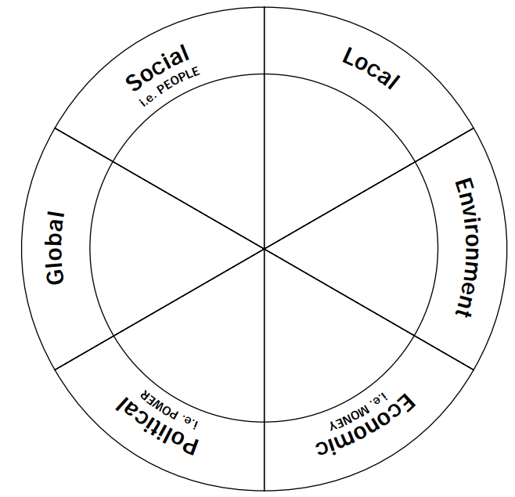
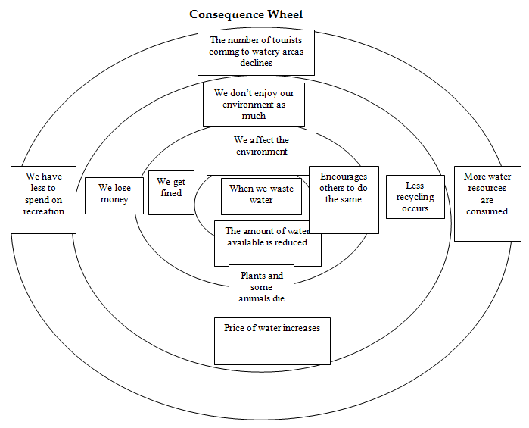
Consequence wheel
From Get Global Education Pack
Notes:
Consequence wheel: In groups, ask learners to put the problem statement in the centre of the circle. On the next ring of the circle they add the effects or impacts of that problem. In the next circle, they add the effects of those issues and so on.

Slide 12
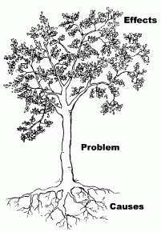
Problem tree / opportunity tree
Notes:
Problem tree
Bring all learners together to create a ‘problem tree’. Quickly watch the demonstration video (30 seconds). Put your ‘problem’ statement at the root of the tree (for example, ‘people forced to leave their homes’). Ask learners to use answers from ‘why, why, why’ to populate the roots of the tree (the root causes of the problem). Give an opportunity for learners to add additional root causes.
Ask learners to use the consequence wheel answers to start to populate the branches of the tree (the impacts). Give learners an opportunity to add more impacts. Learners can continue to add to the tree throughout all the sessions.

Slide 13

UK media coverage of the refugee crisis in Europe
Daily Express Headlines
“Send in army to halt migrant invasion”
“The ‘swarm’ on our streets”
“Illegal migrants flood EU”
“Refugees on benefits trash £1.25 million home”
Daily Mail
“The Battle of Calais: Police use tear gas to repel 300 migrants as they try to storm a road…”
The Sun
“Calais ‘Jungle’ migrant camp to be torn down ‘imminently’… raising fears France will allow refugees to storm Channel Tunnel as Brexit revenge”
OpenDemocracy
“So is it a refugee crisis?”
WalesOnline
“Refugee and asylum-seeking families welcomed to the National Eisteddfod
The Guardian
“From helplessness to hope: inspirational tales of the Refugee Olympic Team”
Notes:
We’ve gained a greater understanding of refugees – why they move, what defines a refugee and the kinds of experiences they have – we are now going to focus on thinking critically about the issues relating to refugees.
Let’s start with what we hear about people seeking sanctuary. Ask learners to think about the media and people they know and to write down common ideas – put these ideas on the board or wall. Discuss and challenge the statements by asking questions.
British print media has been found to be particularly negative and aggressive when reporting the refugee crisis.
Have you noticed any other media coverage of the refugee crisis? How has the coverage made you feel? Has any of the coverage stood out or made a particular impression on you? Why?
What impact might these headlines have on people? Can you think of any examples from your own experiences?
Do these headlines give a true picture of refugees in the UK? Why/Why not? How do you know?
What influences how the media covers the issue of refugees?
How can you check the information in media is accurate or not?
Does the media influence your views on refugees?

Slide 14
Taking action
Task
Look at an example in your group of ordinary people taking action. Discuss and present back:
What is the action?
What is the purpose of the action?
How easy or hard is the action to do?
What has been the impact of the action so far?
How effective is this action do you think?
Notes:
Many people think that we (individually and our governments) should be doing more to support refugees, and that the media don’t give a fair impression. We’re now going to look at ways people take action to improve things for refugees.
There are four case studies about how ordinary people are taking action to support and welcome refugees. Ask learners to work in small groups to look at one case study per group. They should identify, discuss and present:
Feeding the children of Boko Haram’s victims: A baker in Nigeria gives shelter and food
Lobbying councils to take more asylum seekers in Wales: Article lobbying for councils in Wales to take more refugees and the results so far
Fundraising phone credit for refugees: Facebook group raises over £100,000 for refugees to get phone credit to call families
Taking part in rallies to welcome refugees

Slide 15
Plenary
Know | Want | Learnt | Surprise
What do we already know? | What do we want to know? | What have we learned? | What surprised you?
Notes:
Watch the video which brings together some of the themes from the session. Discuss:
Complete table individually or as a class.
Finish with Oxfam’s Stand as One video

